Slide 1

ITEC-200 The Edge of Information Technology
Chapter 8 - Business Processes
Image source: https://itpeernetwork.intel.com/xeon-scalable-powers-future-ai/

Slide 2

Acknowledgements
Professor Ruth A. Guthrie at California Polytechnic University, Pomona, has granted permission for instructors to use and/or modify the presentation for their classes
Dave Hemenway has modified these slides, and has added others, to Professor Guthrie’s excellent slides. He accepts total responsibility for their content.

Slide 3
Chapter 8 Learning Objectives
Define the terms Quality Improvement and Business Process Analysis
Identify the different systems needed to support business processes in an organization
Explain the value of Enterprise Resource Planning (ERP) systems
Explain how business process management and business process reengineering work
Understand how information technology combined with business processes can bring an organization competitive advantage.

Slide 4
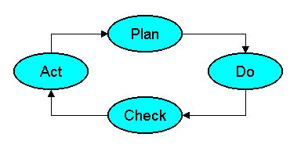
W. Edwards Deming’s Quality Circle (1950) which was based on the work of Walter A. Shewhart (1939)

Slide 5
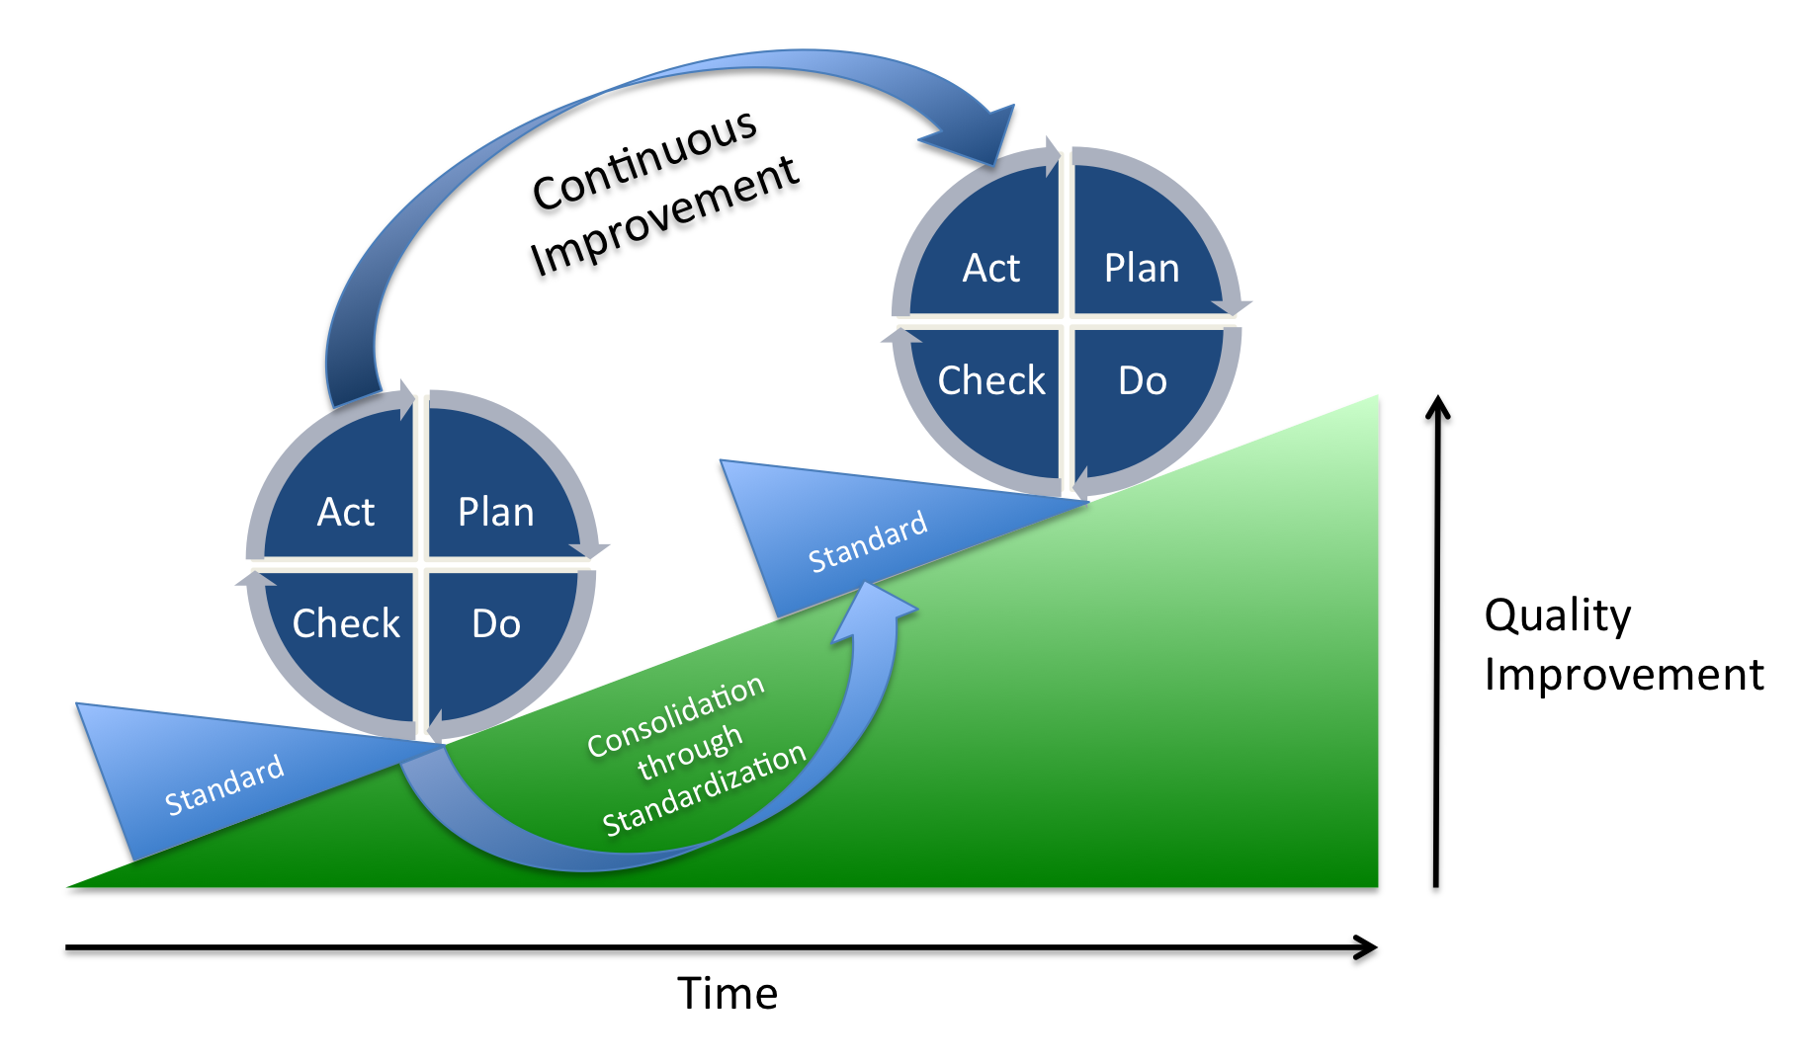
There is no finish line in the race to excellence.

Slide 6
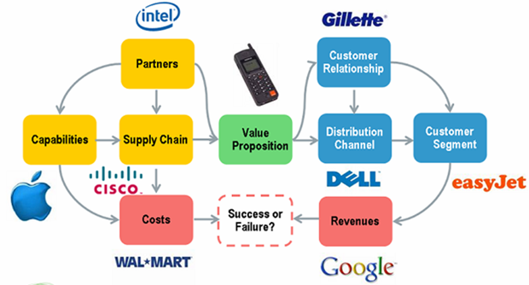
Business Model Definition
A business model is a framework for creating economic or social value. It is often used to represent core aspects of a business, including purpose, offerings, strategies, infrastructure, organizational structure, trading practices, and operational processes and policies.
Image source: http://www.telco2.net/blog/images/BusinessModelChart%20%28Small%29%20%28Custom%29.png

Slide 7
Business Processes Definition
A process: manner in which work is organized and coordinated to produce a product or service
Some business processes take place within a function
Some others cut across multiple business functions
Involves workflows of material, information, or knowledge
Provides unique ways to coordinate work, information, and knowledge

Slide 8
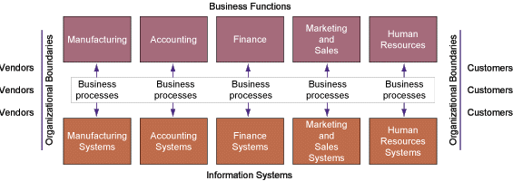
Traditional (obsolete) View of Business – "silos" or "stovepipes"

Slide 9
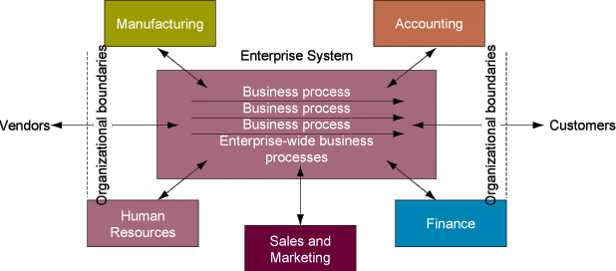
Current View of Enterprise Systems and Business Processes

Slide 10
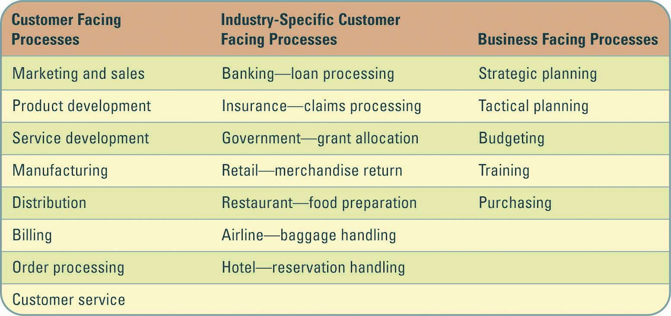
Business Processes Examples

Slide 11
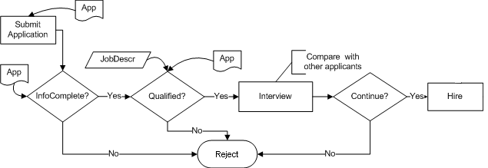
Business Process Example

Slide 12
Business Process Modeling (BPM)
The activity of depicting or representing processes of an organization/enterprise, so that the current process may be analyzed and improved.
BPM is typically performed by business analysts and managers
Goal is to improve process efficiency and quality
Process improvements may or may not require IT involvement

Slide 13
BPM Analysis and Workflow
The analysis of business processes typically includes the mapping of processes and sub-processes down to activity level. A business process model defines the ways in which operations are carried out to accomplish the intended objectives of an organization.
A workflow is a depiction of a sequence of operations, declared as work of a person, of a simple or complex mechanism, of a group of persons, of an organization of staff, or of machines.

Slide 14
Visio Basic Process Model Symbols
Terminator:
start and end
points in a
process
Process Flow:
arrow specifying
process sequence
Process step:
specific step in a
process
Decision: question
or branch in the
process flow
Swim Lanes: show
departments, units or
functional areas
involved
Phase or Separators:
Differentiate phases of a process

Slide 15
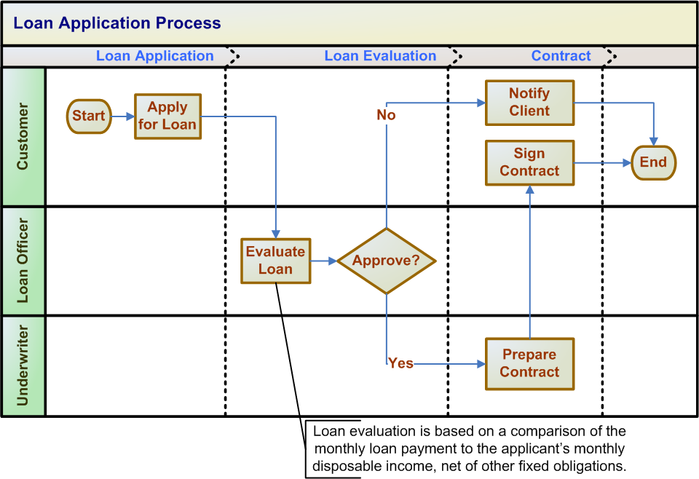
Sample Basic Swim Lane Diagram

Slide 16
More Complicated Swim Lane Diagram

Slide 17
Benefits of BPM
Diagrams can communicate information quickly and clearly
Diagrams often assist in decision-making
Visual format reduces barriers to communication
The potential for misunderstandings is minimized
Diagrams can be connected to original data sources, keeping them current

Slide 18
Business Process Reengineering (BPR)*
Organize around outcomes, not tasks.
Have those who use the outcomes of the process perform the process.
Use information technology to automate
Subsume information-processing work into the real work that produces the information.
Treat geographically dispersed resources as though they were centralized.
Link parallel activities instead of integrating their results.
Put the decision points where the work is performed, and build controls into the process.
Capture information once, at the source.
* Sometimes referred to as "Business Process Improvement" (BPI)

Slide 19
Sample Problem: Car Rental
You have been hired as a business analyst to improve the business process of a small car rental company. The current (i.e., baseline or "as is" ) process is:
When a client enters the agency he/she goes to the rental clerk who retrieves the clients documents (e.g., driver's license, AAA card, etc.). The rental clerk reviews the documents and if not OK, notifies the client who then leaves the agency. If OK, the rental clerk show the vehicle options to the client, who then selects a vehicle. If the vehicle is not available the client selects another vehicle. If the vehicle is available the rental clerk prepares the rental contract and the client signs it. The rental clerk submits the rental contract to the business office where the contract is recorded. The rental clerk then gives the vehicle keys and contract to the client, who then drives off the agency with the vehicle. This process is illustrated in the next slide.

Slide 20
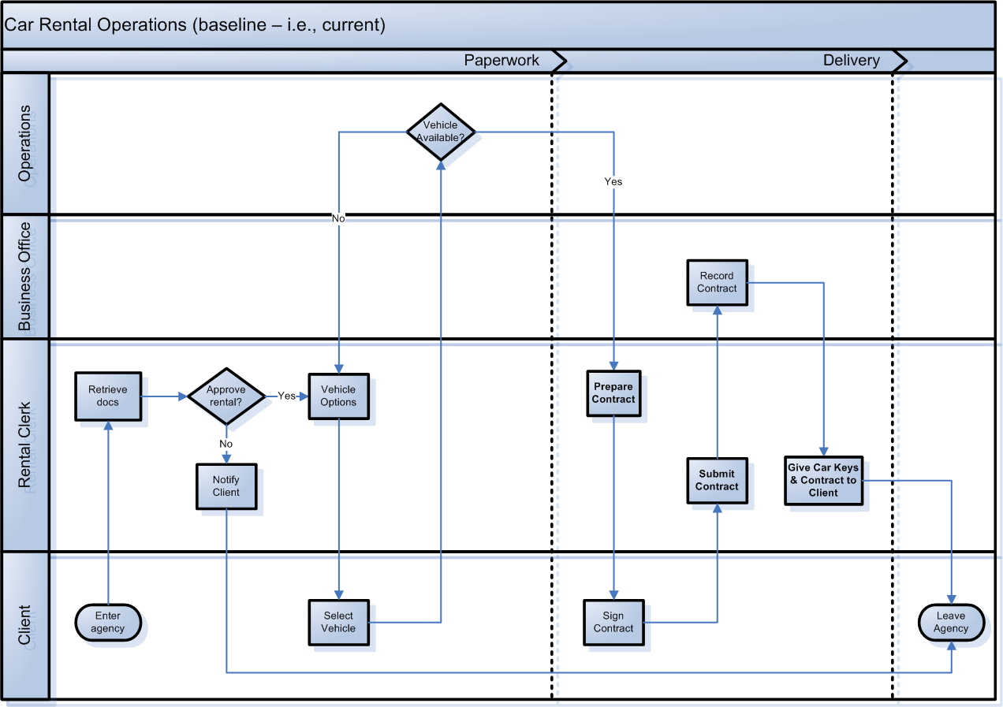
Baseline or As-is Car Rental Process

Slide 21
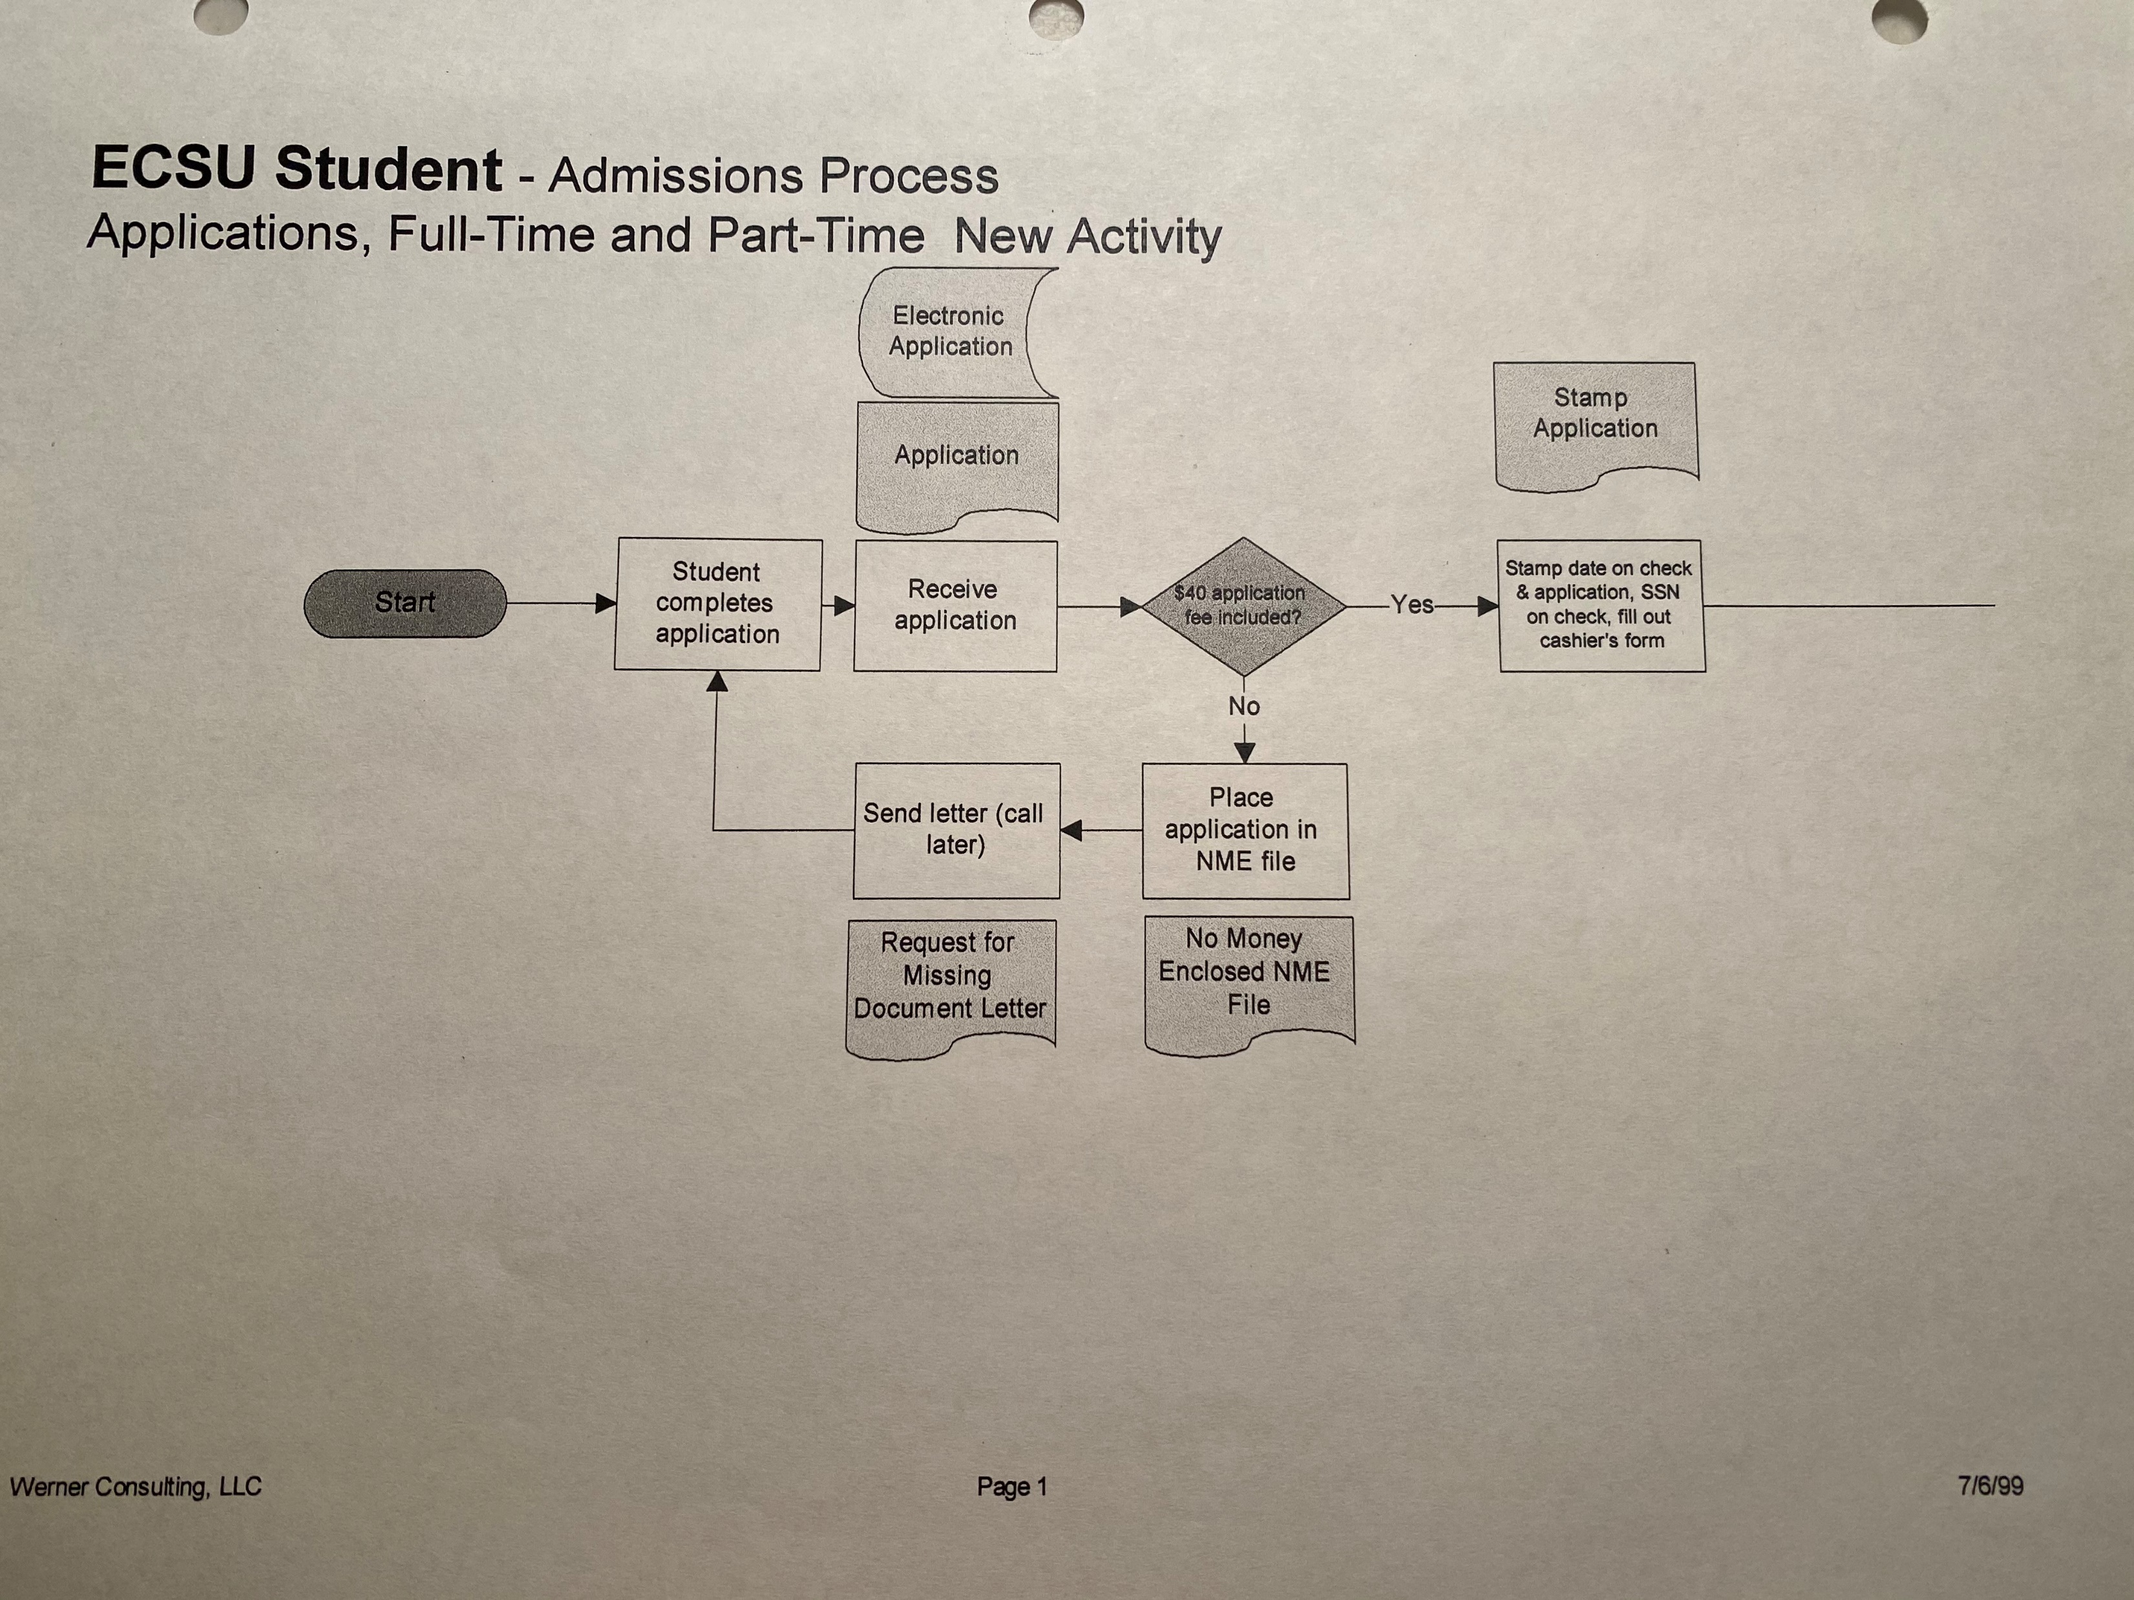

Slide 22
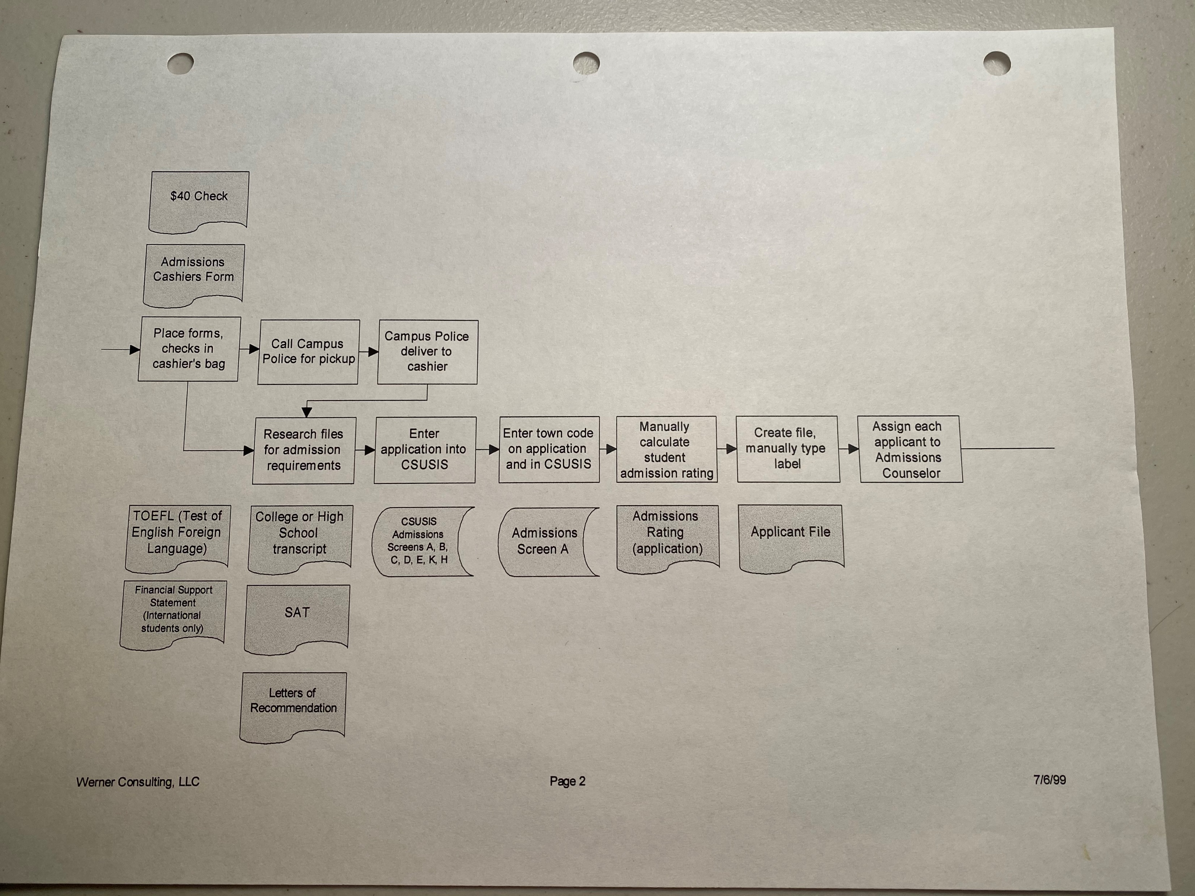

Slide 23
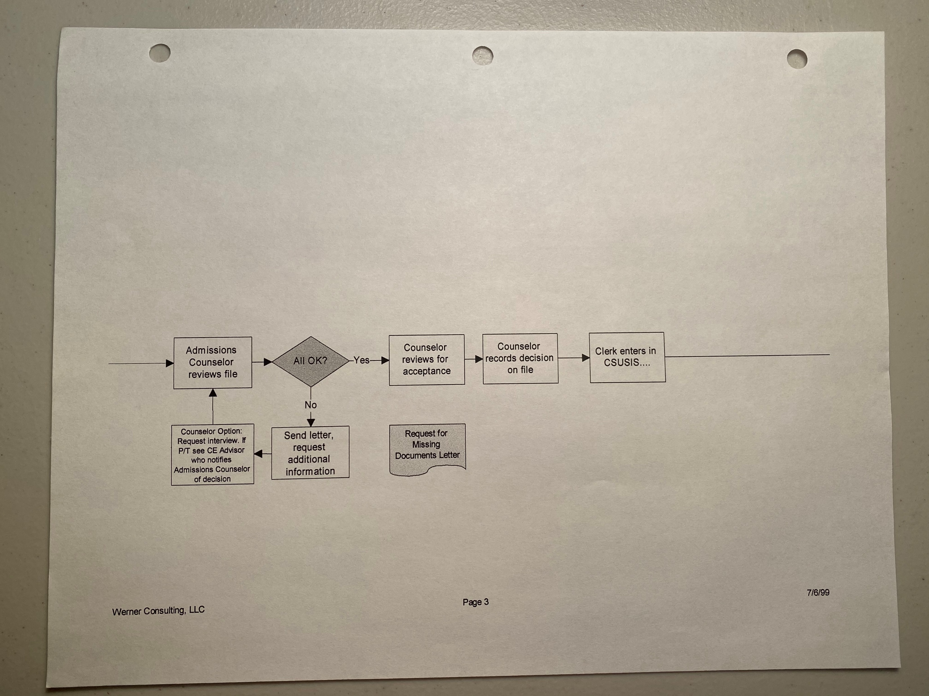

Slide 24
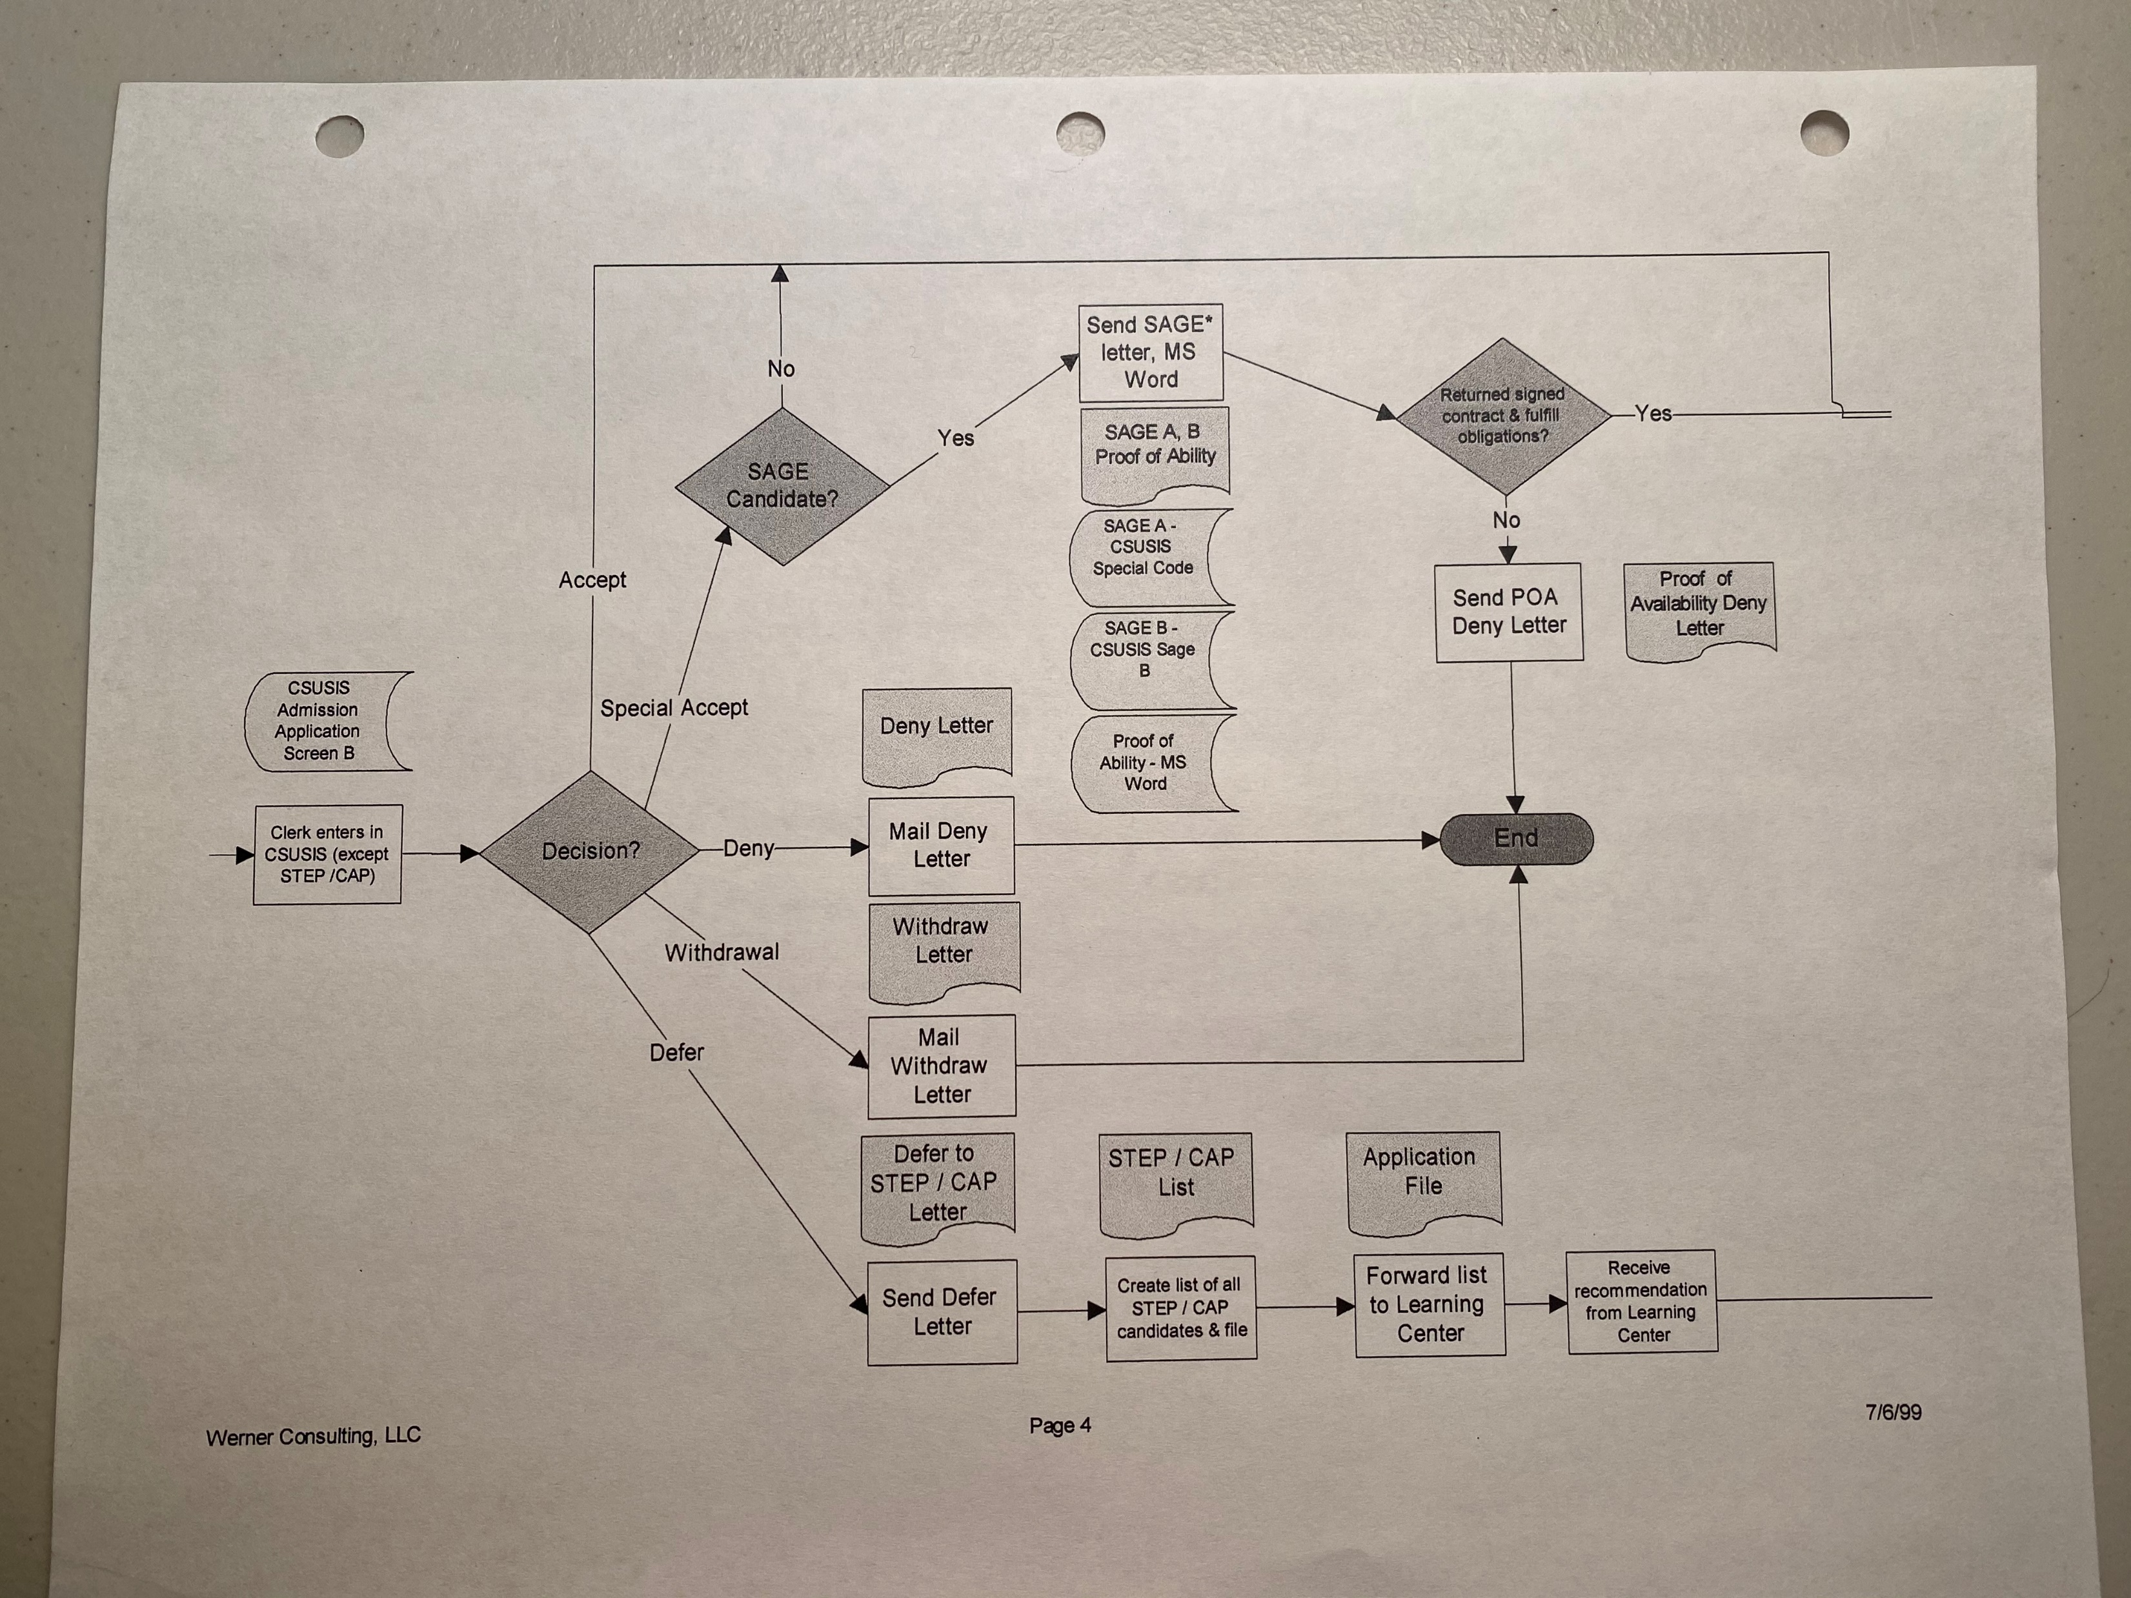

Slide 25
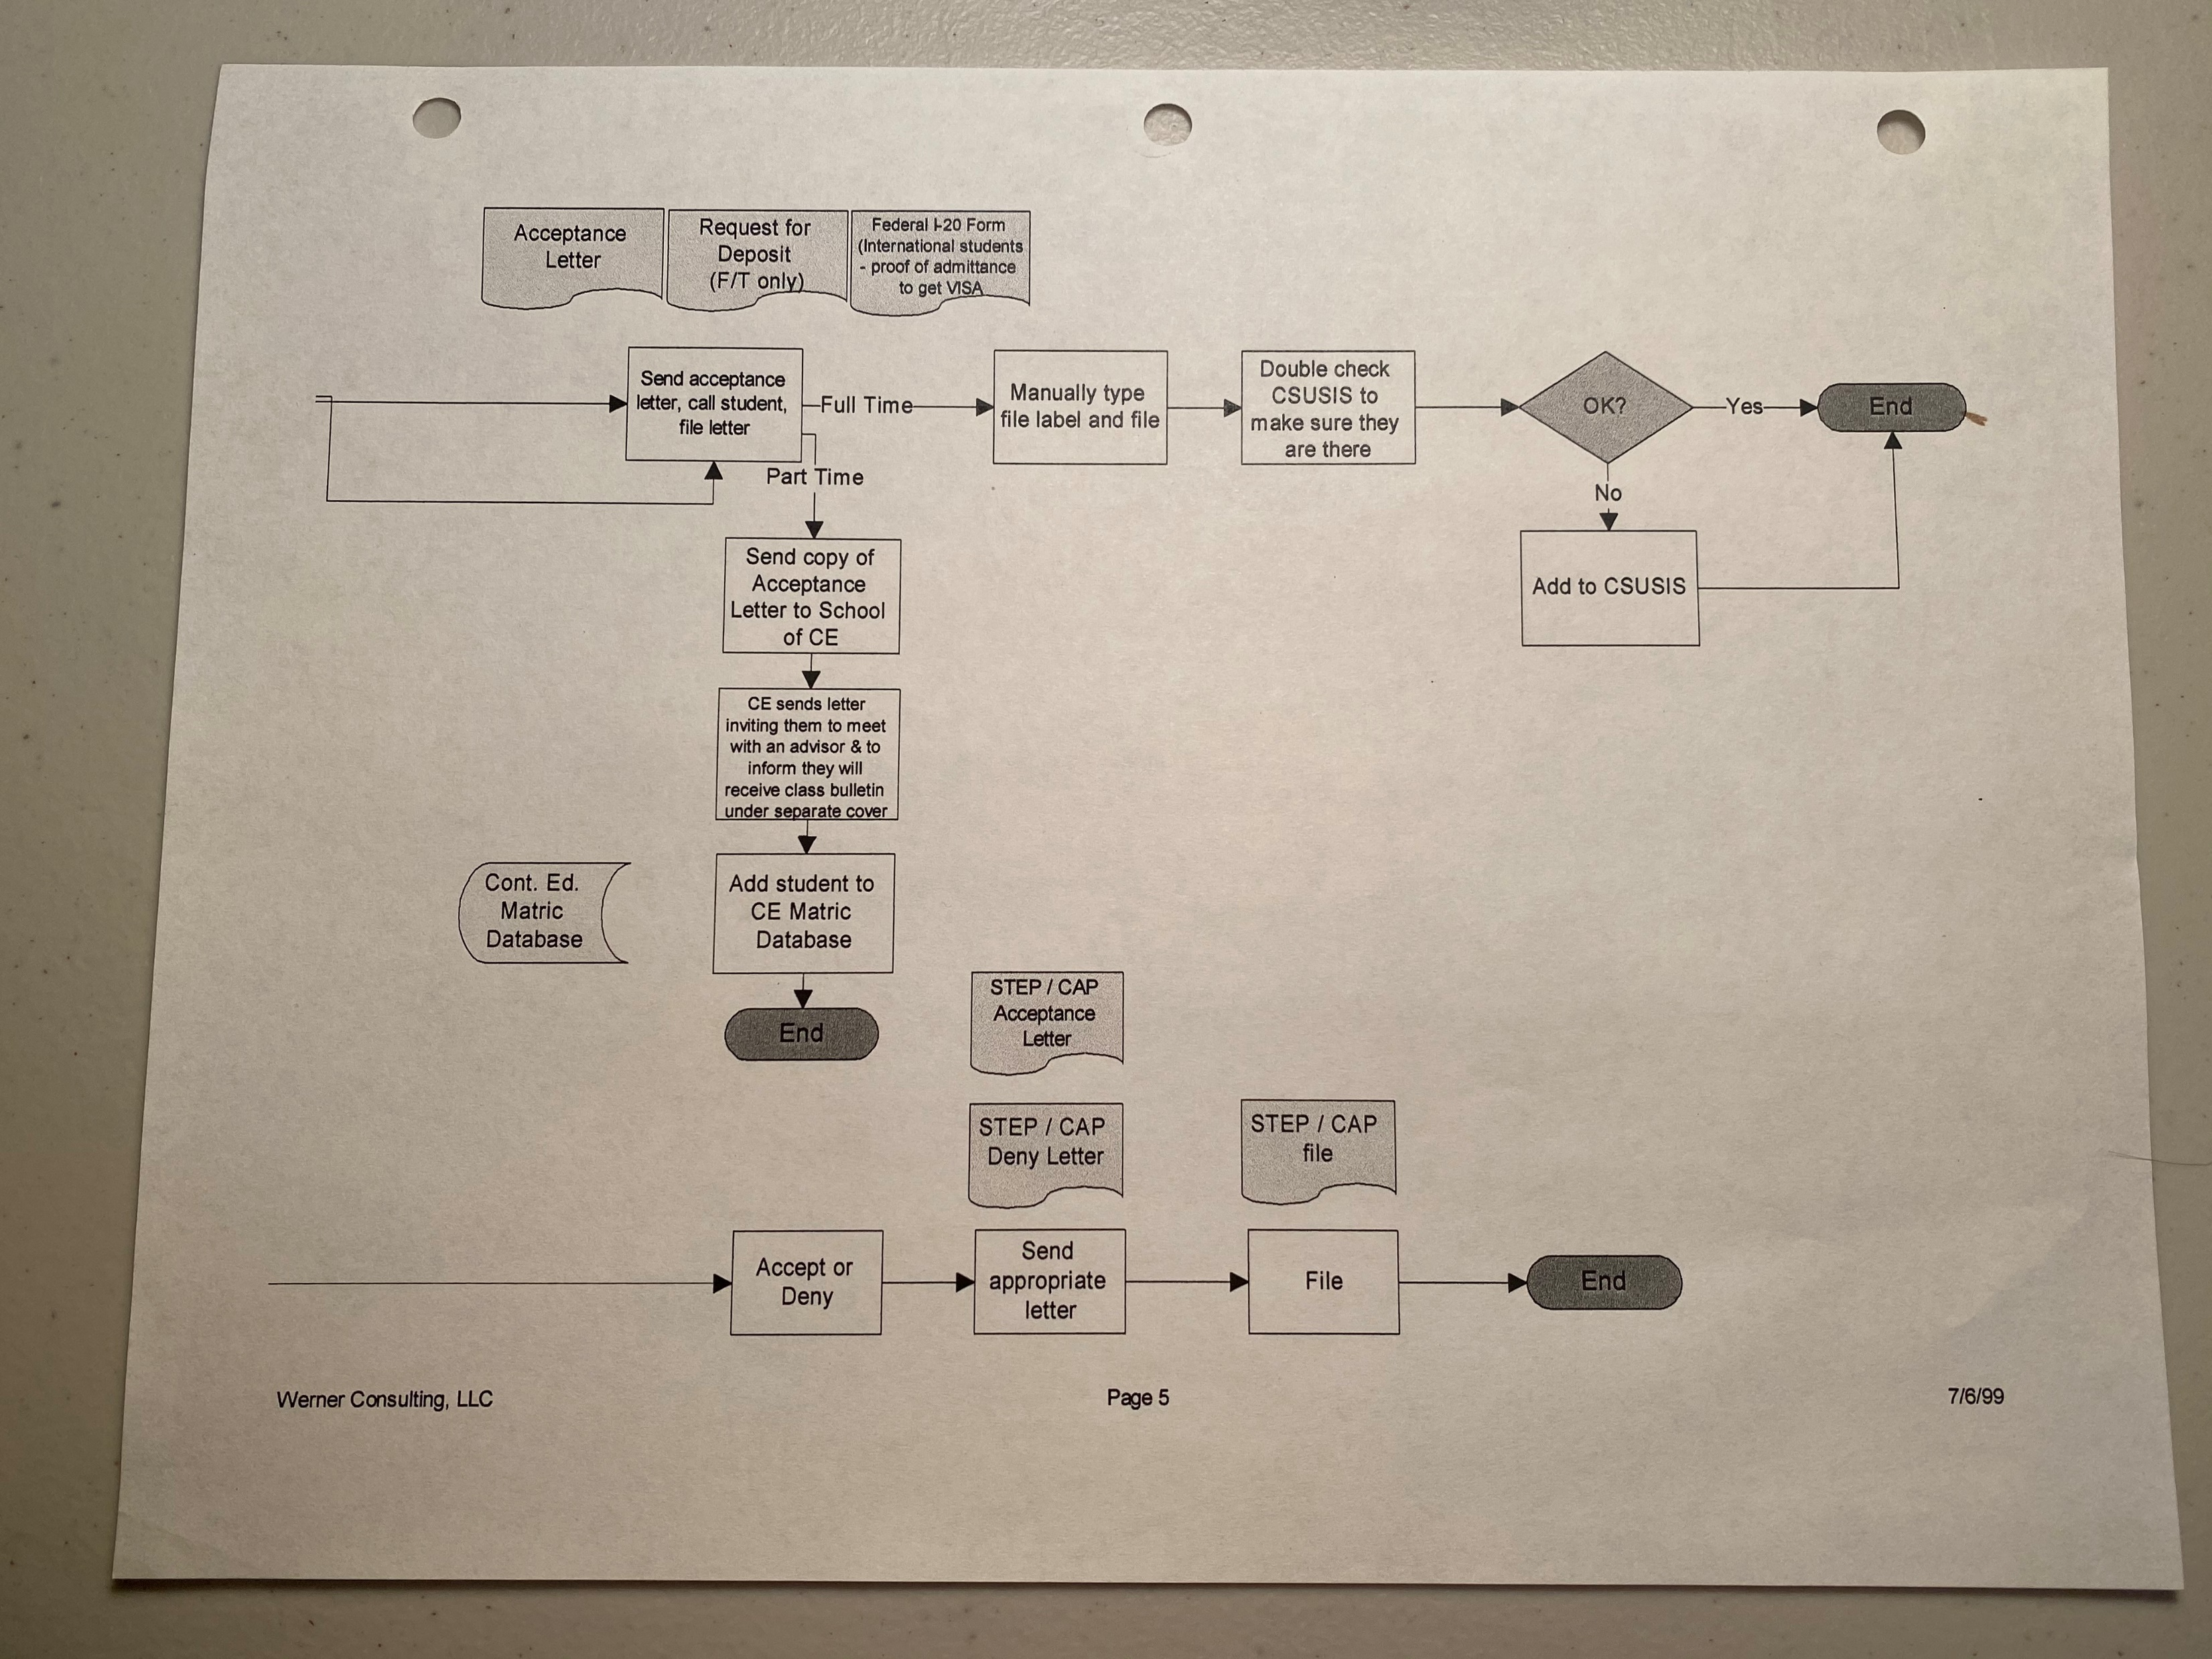

Slide 26
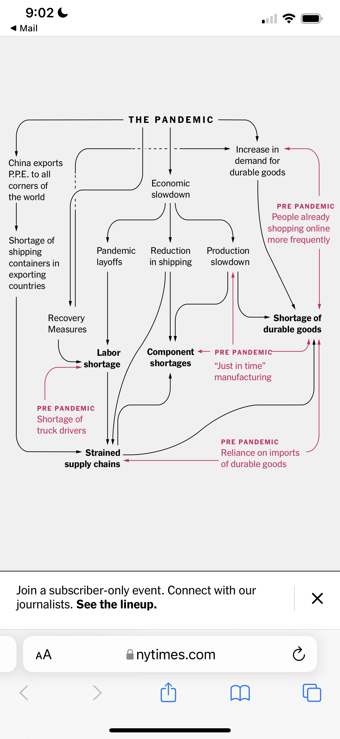

Slide 27
Can a process (a way of doing or making something) be made to perform perfectly?

